Slide 1
Fuzzy and Crisp Relation

Slide 2
Agenda
Crisp Relations
Operation on Crisp Relations
Example on Crisp Relations
Fuzzy Relations
Operations on Fuzzy Relations
Examples on Fuzzy Relations

Slide 3
Crisp Relation
Crisp relation is defined over the cartesian product of two crisp sets. Suppose, A and B are two crisp sets. Then Cartesian product denoted as A×B is a collection of order pairs, such that
A × B = { (a, b) | a ∈ A and b ∈ B }
Note:
A × B ≠ B × A when A ≠ B and A, B are non-empty
|A × B| = |A| × |B|
A × B provides a mapping from a ∈ A to b ∈ B

Slide 4
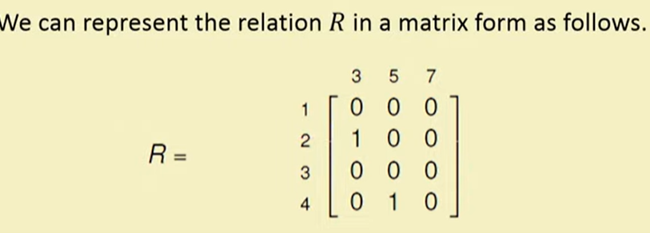
Example of Crisp Relation
Matrix Representation
Note:
0 means ordered pair is not present in relation
1 means ordered pair is part of relation

Slide 5
Operations on Crisp Relation
Suppose, R(x, y) and S(x, y) are the two relations defined over two crisp sets, where x ∈ A and y ∈ B
Union
R ∪ S = χ_{R ∪ S} (x, y) = max( χ_{R}(x, y), χ_{S}(x, y) )
Intersection
R ∩ S = χ_{R ∩ S} (x, y) = min( χ_{R}(x, y), χ_{S}(x, y) )
Complement
R^{c} = χ_{R}c (x, y)= 1 – χ_{R}(x, y)
Cardinality of crisp set:
Cardinality defines the number of elements in the given set. Let A and B be the crisp sets with cardinality n and m, respectively. The cardinality of crisp relation defined over Cartesian product A×B will be n × m

Slide 6
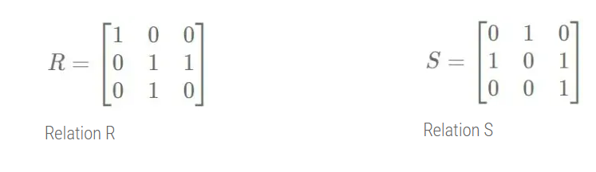
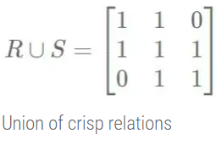
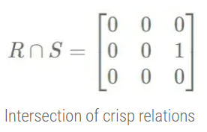
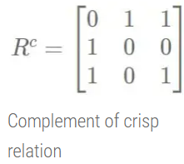
Example
Union of crisp relation:
R ∪ S = χ_{R ∪ S} (x, y) = max( χ_{R}(x, y), χ_{S}(x, y) )
Intersection of crisp relation:
R ∩ S = χ_{R ∩ S} (x, y) = min( χ_{R}(x, y), χ_{S}(x, y) )
Complement of crisp realtion:
R^{c} = χ_{R}c (x, y)= 1 – χ_{R}(x, y)
Cardinality of Crisp Set
A = (1, 2) and B = {3, 4, 5}
Here, n = |A| = 2 and m = |B| =3, So, n×m=6
The cartesian product of both the set,
A × B={ (1, 3), (1, 4), (1, 5),(2, 3), (2, 4), (2, 5) }
Cardinality of cartesian product is, | A × B | = 6 = n × m

Slide 7
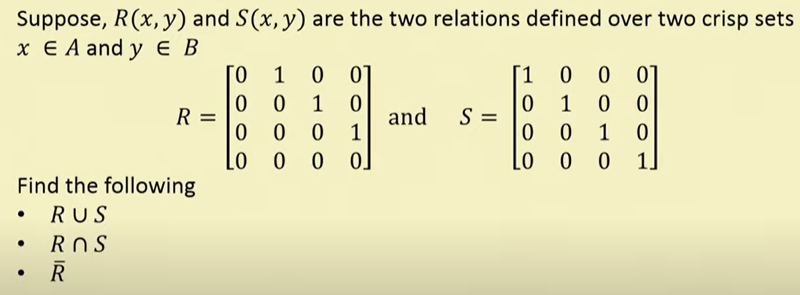
Exercise

Slide 8
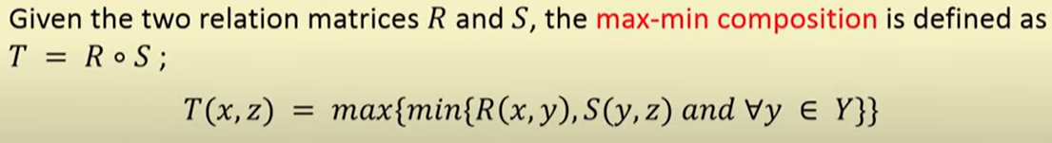
Composition of Relation
Given R is a relation on X,Y and S is another relation on Y,Z. Composition of relation R and S is denoted as R ∘ S. Mathematically, it is defined as,
R ∘ S = {(x, z) | (x, y) ∈ R, and (y, z) ∈ S, ∀y ∈ Y}
A common form of the composition relation is the max-min composition.
Max–min composition

Slide 9
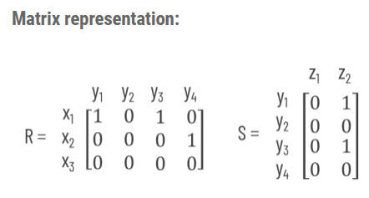
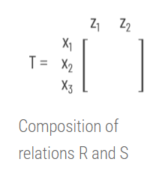
Matrix Representation Max min composition
Let R = { (x₁, y₁), (x₁, y₃), (x₂, y₄) } and S = { (y₁, z₂), (y₃, z₂) } . let us find Max-Min composition of these relation
χ_{T}(x₁, z₁) = max(min( χ_{R}(x₁, y₁), χ_{S}(y₁, z₁)), min( χ_{R}(x₁, y₂), χ_{S}(y₂, z₁)), min( χ_{R}(x₁, y₃), χ_{S}(y₃, z₁)), min( χ_{R}(x₁, y₄), χ_{S}(y₄, z₁))

Slide 10
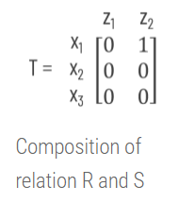
Explanation: Step by Step
Let us see how to fill the cells of composition matrix T
χ_{T}(x₁, z₁) = max(min( χ_{R}(x₁, y₁), χ_{S}(y₁, z₁)), min( χ_{R}(x₁, y₂), χ_{S}(y₂, z₁)), min( χ_{R}(x₁, y₃), χ_{S}(y₃, z₁)), min( χ_{R}(x₁, y₄), χ_{S}(y₄, z₁))
χ_{T}(x₁, z₁) = max(min(1, 0),min(0, 0),min(1, 0),min(0, 0))
χ_{T}(x₁, z₁) = max(0,0,0,0) = 0
Similarly,
χ_{T}(x₁, z₂) = max(min(1, 1),min(0, 0),min(1, 1),min(0, 0)) = max(1, 0, 1, 0) = 1
χ_{T}(x₂, z₁) = max(min(0, 0),min(0, 0),min(0, 0),min(1, 0)) = max(0, 0, 0, 0) = 0
χ_{T}(x₂, z₂) = max(min(0, 1),min(0, 0),min(0, 1),min(1, 0)) = max(0, 0, 0, 0) = 0
χ_{T}(x₃, z₁) = max(min(0, 0),min(0, 0),min(0, 0),min(0, 0)) = max(0, 0, 0, 0) = 0
χ_{T}(x₃, z₂) = max(min(0, 1),min(0, 0),min(0, 1),min(0, 0)) = max(0, 0, 0, 0) = 0
Thus, the composition of relation R and S would be,

Slide 11
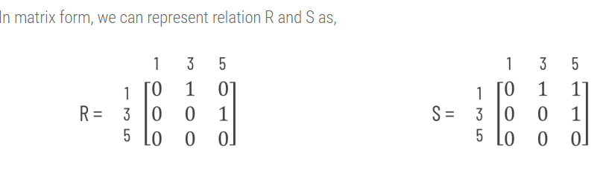
Practice Examples
Given X={1, 3, 5}, Y={1, 3, 5},
R = { (x, y) | y = x + 2 } = { (1, 3), (3, 5) }
S = { (x, y) | x < y } = { (1, 3), (1, 5), (3, 5) }
Find Max-Min composition of relations R and S
X×Y={(1, 1), (1, 3), (1, 5),(3, 1), (3, 3), (3, 5),(5, 1), (5, 3), (5, 5)}
R = { (x, y) | y = x + 2 } = { (1, 3), (3, 5) }
S = { (x, y) | x < y } = { (1, 3), (1, 5), (3, 5) }

Slide 12
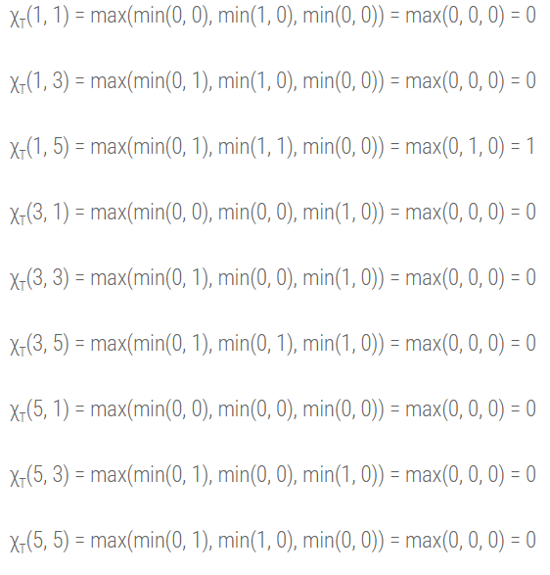
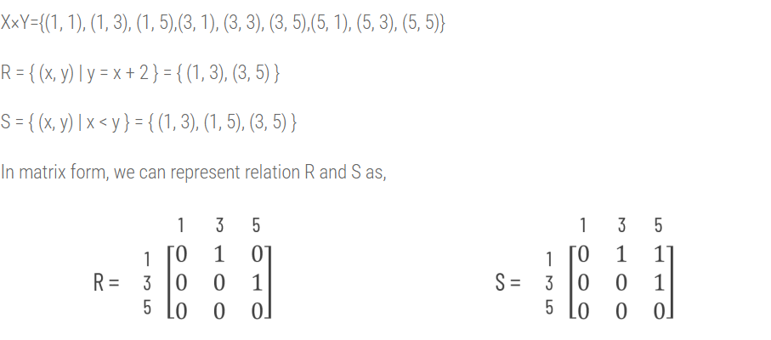

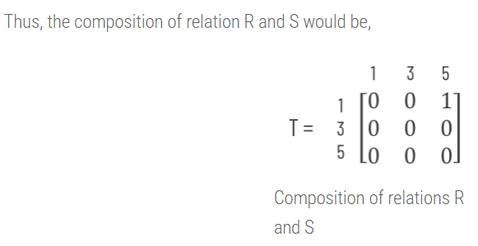
Solution

Slide 13
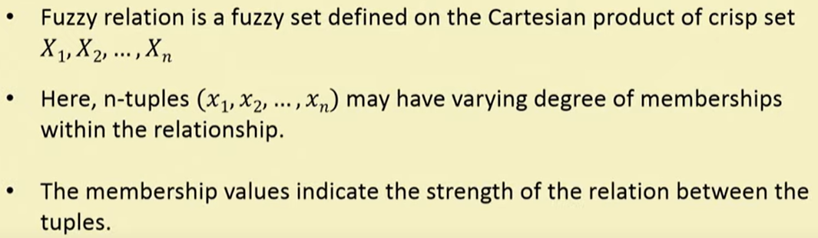
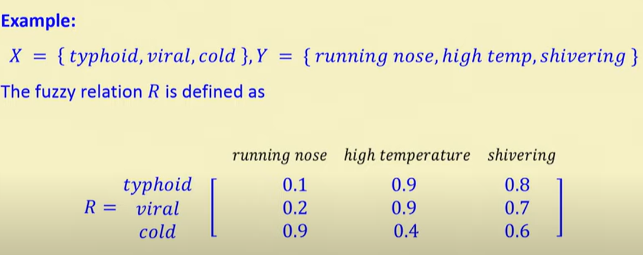
Fuzzy Relation
Defines mapping of variable from one fuzzy set to another

Slide 14
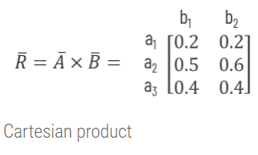
Fuzzy Cartesian Product
Let A be a fuzzy set on universe X and B be a fuzzy set on universe Y, then the Cartesian product between fuzzy sets A and B will result in a fuzzy relation R which is contained with the full Cartesian product space or it is subset of cartesian product of fuzzy subsets. Formally, we can define fuzzy relation as,
R = A x B
and
R ⊂ (X x Y)
where the relation R has membership function,
μ_{R}(x, y) = μ_{A x B}(x, y) = min( μ_{A}(x), μ_{B}(y) )
Given A = { (a₁, 0.2), (a₂, 0.7), (a₃, 0.4) } and B = { (b₁, 0.5), (b₂, 0.6)}, find the relation over A x B

Slide 15

Operation on Fuzzy Relation
Let R and S be fuzzy relation on cartesion space X xY. Then following operationsapply for the membership value for various set operations
Union
Intersection
Complement

Slide 16
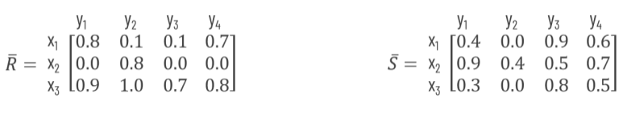
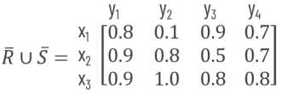
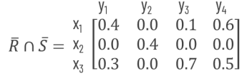
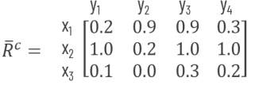
Example
UNION
INTERSECTION
COMPLEMENT
R ∪ S = { (a, b), μ_{A ∪ B}(a, b) }
μ_{R ∪ S}(a, b) = max( μ_{R}(a, b), μ_{S}(a, b))
μ_{R ∪ S}(x₁, y₁) = max( μ_{R}( x₁, y₁ ), μ_{S}( x₁, y₁ ))
= max(0.8, 0.4) = 0.8
μ_{R ∪ S}(x₁, y₂) = max( μ_{R}( x₁, y₂ ), μ_{S}( x₁, y₂ ))
= max(0.1, 0.0) = 0.1
μ_{R ∪ S}(x₁, y₃) = max( μ_{R}( x₁, y₃ ), μ_{S}( x₁, y₃ ))
= max(0.1, 0.9) = 0.9
μ_{R ∪ S}(x₁, y₄) = max( μ_{R}( x₁, y₄ ), μ_{S}( x₁, y₄ ))
max(0.7, 0.6) = 0.7.
………………….
μ_{R ∪ S}(x₃, y₄) = max( μ_{R}( x₃, y₄ ), μ_{S}( x₃, y₄ ) )
= max(0.8, 0.5) = 0.8
R ∩ S = { (a, b), μ_{A ∩ B}(a, b) }
μ_{R ∩ S}(a, b) = min( μ_{R}(a, b), μ_{S}(a, b) )
μ_{R ∩ S}(x₁, y₁) = min( μ_{R}( x₁, y₁ ), μ_{S}( x₁, y₁ ) )
= min(0.8, 0.4) = 0.4
μ_{R ∩ S}(x₁, y₂) = min( μ_{R}( x₁, y₂ ), μ_{S}( x₁, y₂ ) )
= max(0.1, 0.0) = 0.0
μ_{R ∩ S}(x₁, y₃) = min( μ_{R}( x₁, y₃ ), μ_{S}( x₁, y₃ ) )
= max(0.1, 0.9) = 0.1
μ_{R ∩ S}(x₁, y₄) = min( μ_{R}( x₁, y₄ ), μ_{S}( x₁, y₄ ) )
max(0.7, 0.6) = 0.6
…………………..
μ_{R ∩ S}(x₃, y₄) = min( μ_{R}( x₃, y₄ ), μ_{S}( x₃, y₄ ) )
= max(0.8, 0.5) = 0.5
R^{c} = { (a, b), μ_{R}^{c}(a, b) }
μ_{R}^{c}(a, b) = 1 – μ_{R}(a, b)
μ_{R}^{c}(x₁, y₁) = 1 – μ_{R}(x₁, y₁) = 1 – 0.8 = 0.2
μ_{R}^{c}(x₁, y₂) = 1 – μ_{R}(x₁, y₂) = 1 – 0.1 = 0.9
μ_{R}^{c}(x₁, y₃) = 1 – μ_{R}(x₁, y₃) = 1 – 0.1 = 0.9
……………..
μ_{R}^{c}(x₃, y₄) = 1 – μ_{R}(x₃, y₄) = 1 – 0.8 = 0.2

Slide 17
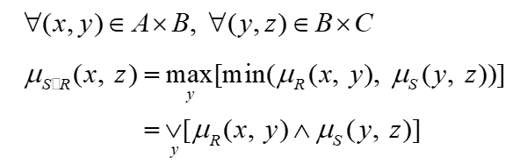
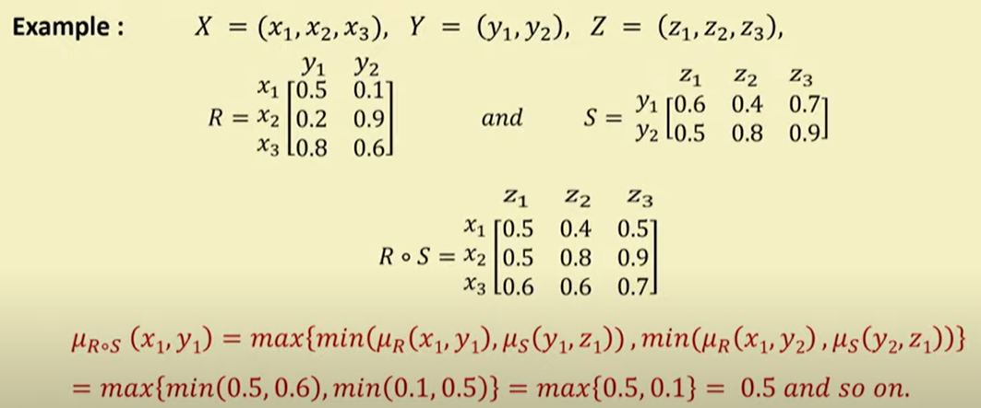
Composition in Fuzzy Relations

Slide 18
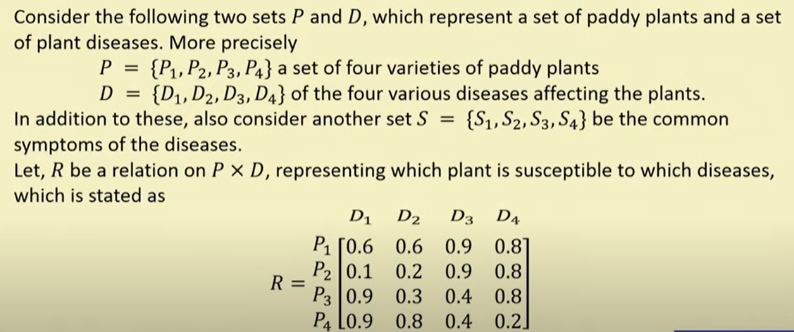
Example 2

Slide 19
